Slide 1
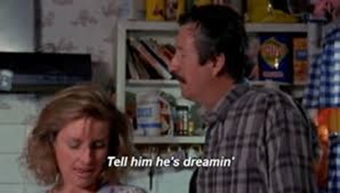
Changing the Australian Constitution
L.G: We will learn about how Australia
can change its constitution.
C.S: 1-We will be able to explain what a
referendum is
2-We will run a referendum in class
and count the results

Slide 2
PowerPoint expectations
If the text is in BLUE then you need to copy it down.
If the text is in RED then it is a task to do.
If the text is in GREEN then it is a discussion point.

Slide 3
Glossary
Term | Definition
Referendum
Plebiscite
A national vote to change one aspect of the Constitution.
When the states of Australia joined together to make a nation in 1901.
A national vote to determine public opinion on a matter not changing the constitution e.g. whether a certain law should be passed or not. (Daylight savings time in WA)

Slide 4

Flow chart: steps of having a referendum
A Bill is passed by Parliament
Case committees are formed
A Writ is issued
Information is provided to voters
Australians vote
You need to make a flowchart worthy of being taken straight to the pool room.

Slide 5

A Bill is passed by Parliament
A Bill setting out the proposed alteration to the Constitution is passed by both Houses of Parliament. If the Bill is passed by one House but rejected, or altered, in the other (and the alterations are unacceptable to the first House) and this is repeated in the next session of the Parliament, the Governor-General may put the proposal to voters as last proposed by the first House with or without any amendments agreed by both Houses.

Slide 6
Case committees are formed
A majority of the Members of the House of Representatives and Senators who voted for the proposal and a majority of those who voted against it are divided into the 'Yes committee' and the 'No committee' for the referendum. These committees are responsible for a range of activities supporting a vote for or against the proposed alteration to the Constitution. When a proposal is passed unanimously by Parliament, a 'No' committee is not formed.

Slide 7
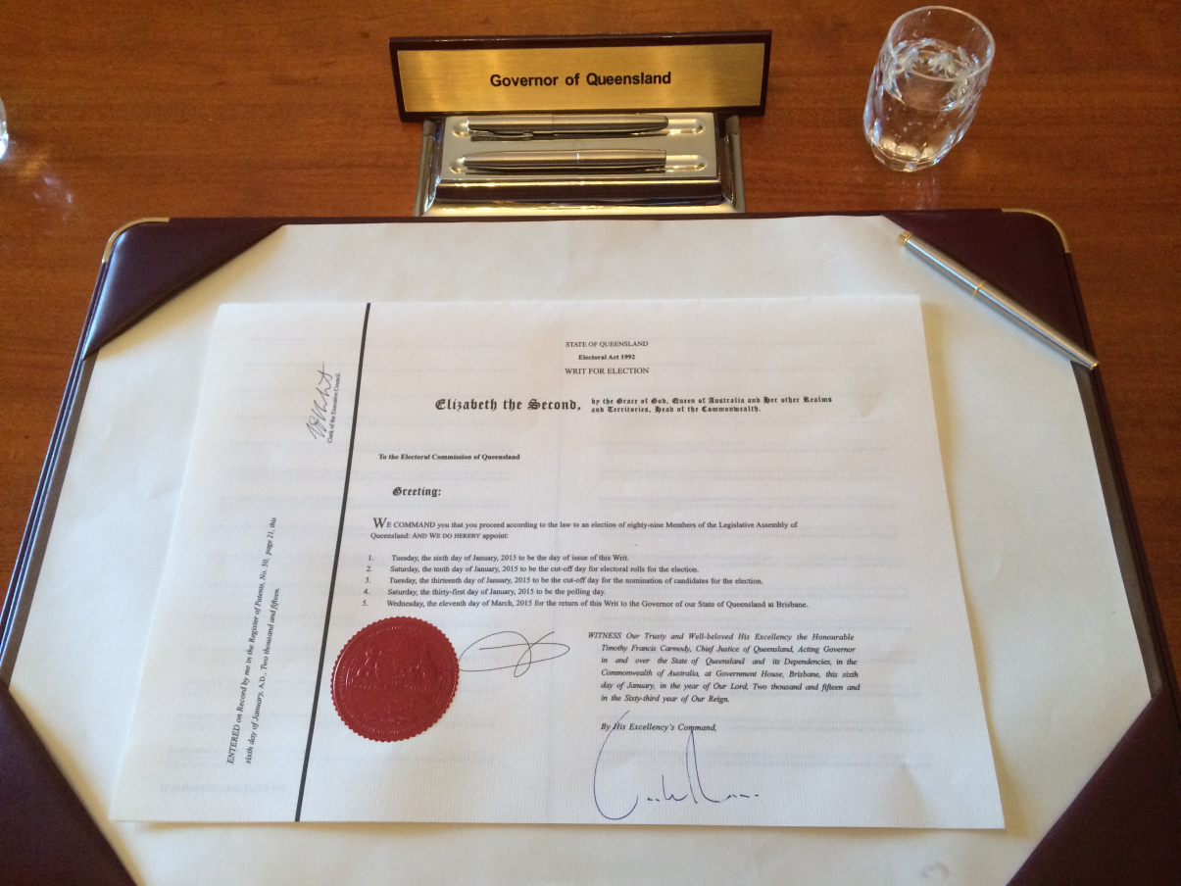
A Writ is issued
The Governor-General issues the Writ for the referendum. The date set for the close of rolls is seven days after the issue of the writ; and polling day, which must be on a Saturday, is not less than 33 days or more than 58 days after the issue of the writ.

Slide 8

Information is provided to voters
In the four weeks after the passage of the Bill, the committees are required to prepare a 'case' for voting 'Yes' and a 'case' for voting 'No'. These cases are lodged with the Electoral Commissioner, and are printed together with a statement showing the proposed alterations. This must be posted to every voter on the electoral roll, as nearly as practicable no later than 14 days before polling day.

Slide 9

Australians vote
Voting in a referendum is similar to casting a vote in the federal election. Polling places are established in all federal divisions, and polling day is always a Saturday. The key difference is what voters are required to write on their referendum ballot paper. In a referendum, voters are required to write either 'Yes' or 'No' in the box opposite each question on the ballot paper. If the referendum is carried, the proposed law is given Royal Assent by the Governor-General.

Slide 10

Class plebiscite!
Should students who hand their work in late be penalised?

